Slide 1
Python logging
The logging module is part of the standard Python library and provides tracking for events that occur while software runs. You can add logging calls to your code to indicate what events have happened.
The logging module allows for both diagnostic logging that records events related to an application’s operation, as well as audit logging which records the events of a user’s transactions for analysis. It is especially used to record events to a file.
Use the logging Module:
The logging module keeps a record of the events that occur within a program, making it possible to see output related to any of the events that occur throughout the runtime of a piece of software.

Slide 2
You may be more familiar with checking that events are occurring by using the print() statement throughout your code. The print() statement does provide a basic way to go about debugging your code to resolve issues.
Logging Works :
The logging is a powerful module used by the beginners as well as enterprises. This module provides a proficiency to organize different control handlers and a transfer log messages to these handlers.
To releasing a log message, we need to import the logging module as follows.
“import logging”
Now, we will call the logger to log messages that we want to see. The logging module offers the five levels that specify the severity of events.
Each event contains the parallel methods that can be used to log events at the level of severity. Let's understand the following events and their working.

Slide 3
DEBUG - It is used to provide detailed information and only use it when there is diagnosing problems.
INFO - It provides the information regarding that things are working as we want.
WARNING - It is used to warn that something happened unexpectedly, or we will face the problem in the upcoming time.
ERROR - It is used to inform when we are in some serious trouble, the software hasn't executed some programs.
CRITICAL - It specifies the serious error, the program itself may be incapable of remaining executing.

Slide 4
The above levels are sufficient to handle any types of problems. These corresponding numerical values of the levels are given below.
The logging module offers many features. It consists of several constants, classes, and methods. The constants are represented by the all caps latter; the classes are represented by capital letters. The items with lowercase represent methods.
Level | Numeric Value | Function
CRITICAL | 50 | logging.critical()
ERROR | 40 | logging.error()
WARNING | 30 | logging.warning()
INFO | 20 | logging.info()
DEBUG | 10 | logging.debug()

Slide 5
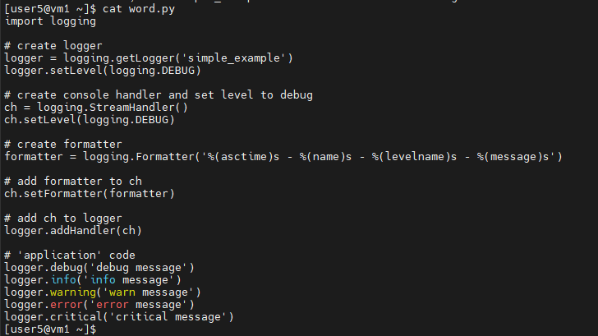
Python logging simple example:

Slide 6
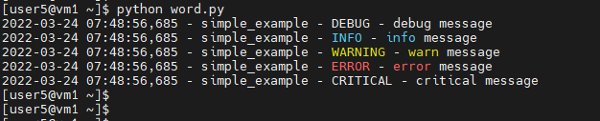
Output:
Conclusion:
Debugging is an important step of any software development project. The logging module is part of the standard Python library, provides tracking for events that occur while software runs, and can output these events to a separate log file to allow you to keep track of what occurs while your code runs. This provides you with the opportunity to debug your code based on understanding the various events that occur from running your program over time

